Slide 1
File Manager Tool
A Python Application for File and Directory Management
Made BY:
Aliyan Ahmed Cheema
FA22-BCE-028

Slide 2

What is the File Manager GUI?
The File Manager GUI is a Python-based desktop application that enables users to manage files and directories through an intuitive graphical interface. It allows users to perform common file operations like listing contents, creating files, and deleting files easily.
Key objective: "Simplify file management tasks for non-technical users

Slide 3
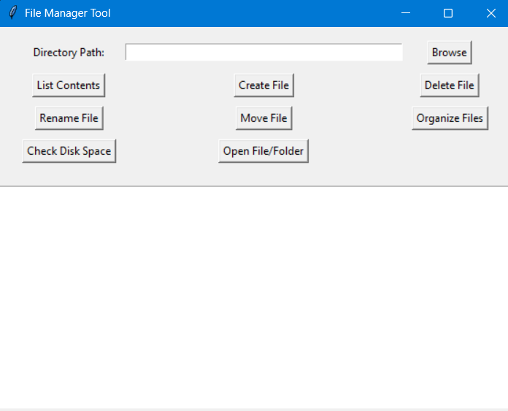
Features of the File Manager
List the contents of a directory.
Create new files.
Delete existing files.
Rename files or folders.
Move files to a new location.
Open files or folders.
Organize files by type into subfolders.
Check disk space usage of directories.

Slide 4
Technologies Used
Programming Language: Python.
Libraries:
os: Core file operations.
shutil: Advanced file manipulation like moving files.
tkinter: For creating the graphical user interface.
Why these technologies were chosen: "They are lightweight, built-in with Python, and suitable for desktop applications."

Slide 5
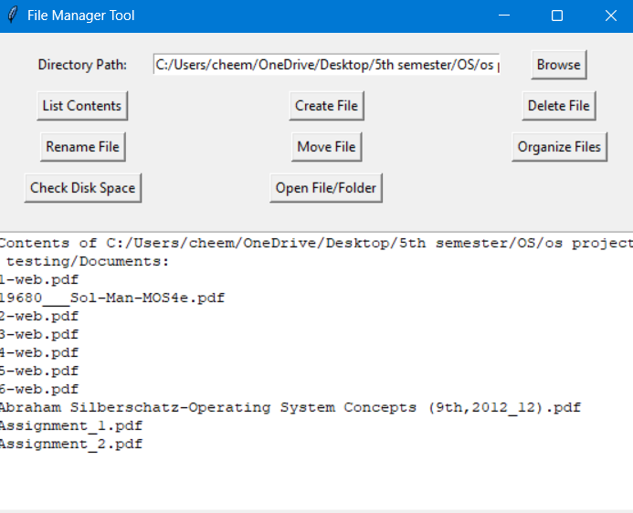
User Interface Overview

Slide 6
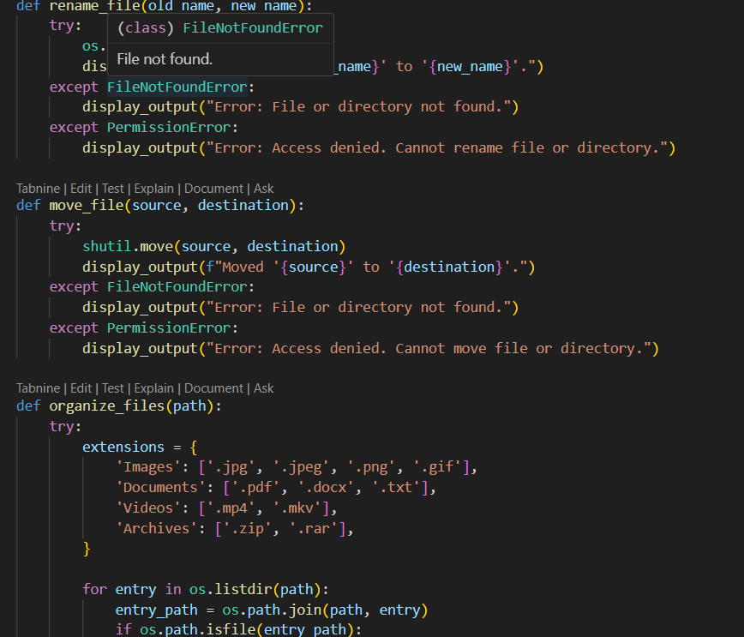
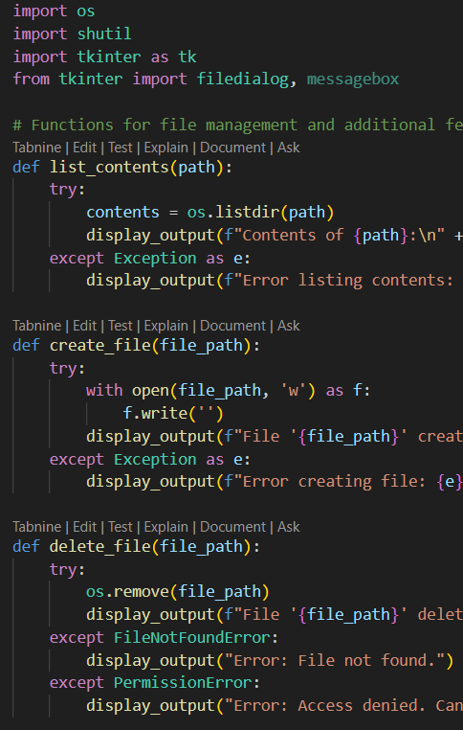
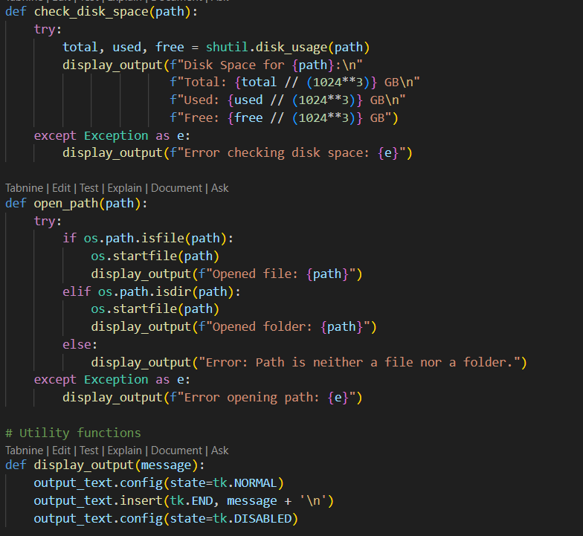
Project Code Structure
File Handling Functions: Manage files and directories.
Utility Functions: For displaying output in the GUI.
Event Handlers: Link buttons to respective functions.
GUI Setup: Defines the graphical interface elements.

Slide 7

Key Functions
list_contents(path): Lists files and folders in a directory.
create_file(path): Creates an empty file.
delete_file(path): Deletes a specified file.
rename_file(old_name, new_name): Renames a file or folder.
move_file(source, destination): Moves a file to a different location.
open_path(path): Opens a file or folder.

Slide 8
Demonstration

Slide 9
Conclusion
The File Manager GUI simplifies file management tasks with a user-friendly interface. It leverages Python libraries to handle files effectively.
Key learning outcomes:
Hands-on experience with Python and Tkinter.
Understanding of file handling and GUI design.

Slide 10

Thank you!

